Slide 1
Quantum computers
Very basic introduction

Slide 2
Who?
David Deutsch (Oxford University)
Peter Shor (MIT)
Ronald Hanson (Qutech Center – TU Delft)
2017 prototype (IBM, online service)

Slide 3
What?
Quantum mechanics
Parallel calculations
Huge amount of data

Slide 4
Quantum physics
Basically multi-existance
Youtube: double-slit experiment

Slide 5
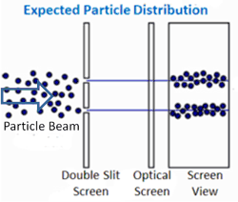
Solid matter

Slide 6
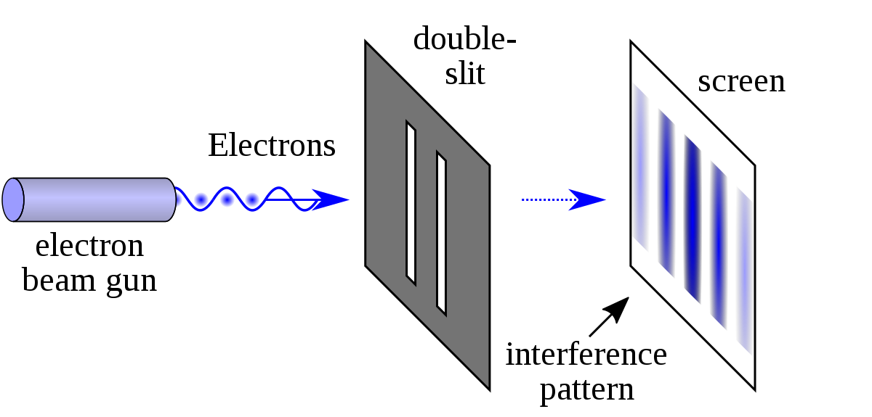
Electrons

Slide 7
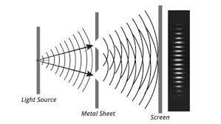
Wave pattern

Slide 8
How?
Superposition
Quantum entanglement
Interference
Qubits (quantum memory)
Notes:
Superposition : spin of a particle can have all possible values at the same time
Quantum entanglement : two paired particles. If you measure 1, you IMMEDIATLY know the state-space representation of the other one
Interference : wave character of element gets strengthened or weakened out by other element
Qubits: when three factors are used correctly: manipulate quantum element in the chip from different positions

Slide 9
Why?
10¹⁴ quicker
Enormous databases

Slide 10
Current situation
Specific languages like QCL
Still very instable
Study of molecule behaviour

Slide 11
Future consequences
Scientific research (quantum machine learning)
Leasure (games, movies, …)
Problem: online security
Notes:
key generation (prime numbers)

Slide 12
Q&A
Thank you for your attention!

